Slide 1
Data Flow Diagram of Hostel Management System

Slide 2
ER-Model
Hostel
Student
Room
Admin (Mess, Hostel Accounts Manager)
Visitors
Mess
Attendance
Payment Table
Notice Board
Entity Sets identification

Slide 3
1 / Hostel Attributes And Types:
Hostel_ID (PK)
Name
Hostel
No_Of_Students
No_Of_Rooms

Slide 4
2 / Student Attributes And Types:
F_Name
Student_Id (PK)
Password
F_Name
Department
Address
fee_status
Student
Hostel_ID (Fk)
Created_By_Admin_ID
(FK)
Room_ID (Fk)
Contact information
mess_status
FatherName
Email
fingerprint_data

Slide 5
3 / Room Attributes And Types:
Floor_No
Room_Type
Room_Id
Location
Students_Alloted
Room
Student_ID(FK)
Room_No
Capacity

Slide 6
4 / Admin Attributes And Types:
Admin_ID (PK)
Contact_Information
Created_At
Admin_Role
Admin
Email
Name
password
Updated_At

Slide 7
5 / Visitors Attributes And Types:
Approved_By
Approval_Status
Time_in
Contact_Information
Visitors
Visistor_Name
Requested_By
Visistor_ID (PK)
Time_out
Visitor_Friend
Request_Date

Slide 8
6 / Student Complaints Attributes And Types:
Complaint_Types
Complaint_Description
Student_ID (FK)
Complaints
Updated_At
Admin_ID (FK)
Complaints_ID (PK)
__________________
Created_At

Slide 9
7 / Student Mess Attributes And Types:
Hostel_ID (FK)
Mess_ID (PK)
______________
fingerprint_data
Mess
Student_ID (FK)

Slide 10
8 / Student Mess Attandance Attributes And Types:
Hostel_ID (FK)
Admin_ID (FK)
Mess_ID (FK)
______________
Attendance_ID (PK)
fingerprint_data
Status
Mess Attendance
Student_ID (FK)
Fingerprint_Data (The actual fingerprint data stored for verification purposes (typically stored as a blob or hash)
Created_At
Date

Slide 11
8 / Payment Table Attributes And Types:
Student_ID (FK)
Payment Date
Fee_Type
Payment Table
Recipient Number
Fee Status
Payment_ID
Amount Paid

Slide 12
Relationships Between Them

Slide 13
Relationships Between Them
Relationships:
One-to-Many:
Hostel ↔ Room
Hostel ↔ Student
Room ↔ Student
Student ↔ Payment
Student ↔ Complaint
Student ↔ Attendance
Mess ↔ Attendance
Many-to-One:
Attendance ↔ Admin
Complaint ↔ Admin

Slide 14
1 / Hostel _ Room:
Floor_No
Hostel_ID (PK)
Room_N0
Room_Type
Room_Id (PK)
Name
Location
Hostel
Allotted
Room
Admit_Date
Student_ID(FK)
Students_Alloted
No_Of_Rooms
Capacity
No_Of_Students

Slide 15
2 / Hostel _ Student:
F_Name
Password
Hostel_ID (PK)
F_Name
Student_Id (PK)
Name
Department
Address
Hostel
Allotted
Student
Hostel_ID (Fk)
No_Of_Students
Created_By_Admin_ID
(FK)
mess_status
Contact information
fee_status
No_Of_Rooms
FatherName
Email
fingerprint_data
Room_ID (Fk)

Slide 16
3 / Room _ Student:
F_Name
Password
Room_Id(PK)
Floor_No
F_Name
Student_Id (PK)
Room_Type
Location
Department
Address
Room
Allotted
Student
Hostel_ID (Fk)
Student_ID(FK)
Created_By_Admin_ID
(FK)
mess_status
Contact information
Capacity
fee_status
FatherName
Room_No
fingerprint_data
Email
Room_ID (Fk)

Slide 17
4 / Student ↔ Payment
Password
F_Name
Address
Recipient Number
Payment Date
F_Name
Student_Id (PK)
fee_status
Department
Fee_Type
Fee Status
Payment Table
Hostel_ID (Fk)
Student
Records
Student_ID (FK)
mess_status
Created_By_Admin_ID
(FK)
Contact information
Payment_ID
FatherName
Amount Paid
fingerprint_data
Room_ID (Fk)
Email

Slide 18
5 / student ↔ Complaint
Password
F_Name
Address
Student_ID (FK)
F_Name
Student_Id (PK)
Complaint_
Description
fee_status
Complaint_Types
Department
Admin_ID (FK)
Complaints
Student
Hostel_ID (Fk)
Records
mess_status
Created_By_Admin_ID
(FK)
Contact information
Created_At
Updated_At
FatherName
Complaints_ID (PK)
__________________
Room_ID (Fk)
Email
fingerprint_data

Slide 19
6/ Student ↔ Attendance
Password
F_Name
Address
Hostel_ID (FK)
Mess_ID (FK)
______________
Admin_ID (FK)
F_Name
Student_Id (PK)
fee_status
Attendance_ID (PK)
Department
Status
Mess Attendance
Student
Hostel_ID (Fk)
Records
Student_ID (FK)
Fingerprint_Data (The actual fingerprint data stored for verification purposes (typically stored as a blob or hash)
mess_status
Created_By_Admin_ID
(FK)
Contact information
Date
FatherName
Room_ID (Fk)
Email
fingerprint_data
Created_At
fingerprint_data

Slide 20
7/ Mess ↔ Attendance
Hostel_ID (FK)
Hostel_ID (FK)
Mess_ID (FK)
______________
Mess_ID (PK)
______________
Admin_ID (FK)
Attendance_ID (PK)
Status
Mess Attendance
Mess
Records
Student_ID (FK)
fingerprint_data
Fingerprint_Data (The actual fingerprint data stored for verification purposes (typically stored as a blob or hash)
Date
Student_ID (FK)
Created_At
fingerprint_data

Slide 21
8/ Attendance ↔ Admin
Created_At
Hostel_ID (FK)
Mess_ID (FK)
______________
Contact_Information
Admin_ID (FK)
Admin_ID (PK)
Attendance_ID (PK)
Email
Admin_Role
Status
Mess Attendance
Admin
Records
Student_ID (FK)
Name
Date
Fingerprint_Data (The actual fingerprint data stored for verification purposes (typically stored as a blob or hash)
password
Created_At
fingerprint_data
Updated_At

Slide 22
9/ Complaint ↔ Admin
Created_At
Contact_Information
Student_ID (FK)
Complaint_Description
Admin_ID (PK)
Complaint_Types
Email
Admin_Role
Complaints
Admin
Records
Name
Admin_ID (FK)
password
Created_At
Updated_At
Updated_At
Complaints_ID (PK)
__________________

Slide 23
Logical Design

Slide 24
1. Hostel
2. Student
Hostel_ID (Primary Key)
Hostel_Name
Address
No_Of_Rooms
No_Of_Student
Single_Seater_Rooms
Two_Seater_Rooms
Three_Seater_Room
Six_Seater_Rooms
Student_ID (Primary Key)
F_Name
L_Name
Created_By_Admin_ID
Password
Contact_Info
Address
Department
FatherName
Email
fee_status
mess_status
fingerprint_data
Room_ID (Foreign Key referencing Room)
Hostel_ID (Foreign Key referencing Hostel)

Slide 25
3. Room
4. Admin
Admin_ID (Primary Key)
Name
Passord
Email
Contact_Information
Admin_Role
Created_At
Updated_At
Room_ID (Primary Key)
Room_Type
Capacity
Location
Room_No
Floor_No
Students_Alloted
Hostel_ID (Foreign Key referencing Hostel)

Slide 26
5. Visitors
6. Complaint
Visitor_ID (Primary Key)
Visitor_Name
Contact_Info
Time_in
Time_out
Student_ID (Foreign Key referencing Student)
Requested_By
Approved_By
Approval_Status
Request_Date
Complaint_ID (Primary Key)
Student_ID (Foreign Key referencing Student)
Admin_ID (Foreign Key referencing Admin)
Complaint_Description
Complaint_Type
Created_At
Updated_At

Slide 27
7. Mess
8. Mess Attendance
Attendance_ID (Primary Key)
Student_ID (Foreign Key referencing Student)
Mess_ID (Foreign Key referencing Mess)
Admin_ID (FK)
Date
Status
Created_At
Fingerprint_Data (The actual fingerprint data stored for verification purposes (typically stored as a blob or hash)
Mess_ID (Primary Key)
Hostel_ID (Foreign Key referencing Hostel)
Mess_Menu
Created_At

Slide 28
9. Payment Table
Payment_ID (Primary Key)
Student_ID (Foreign Key referencing Student)
Fee_Type
Payment_Date
Amount_Paid
Receipt_Number
Fee_Status

Slide 29
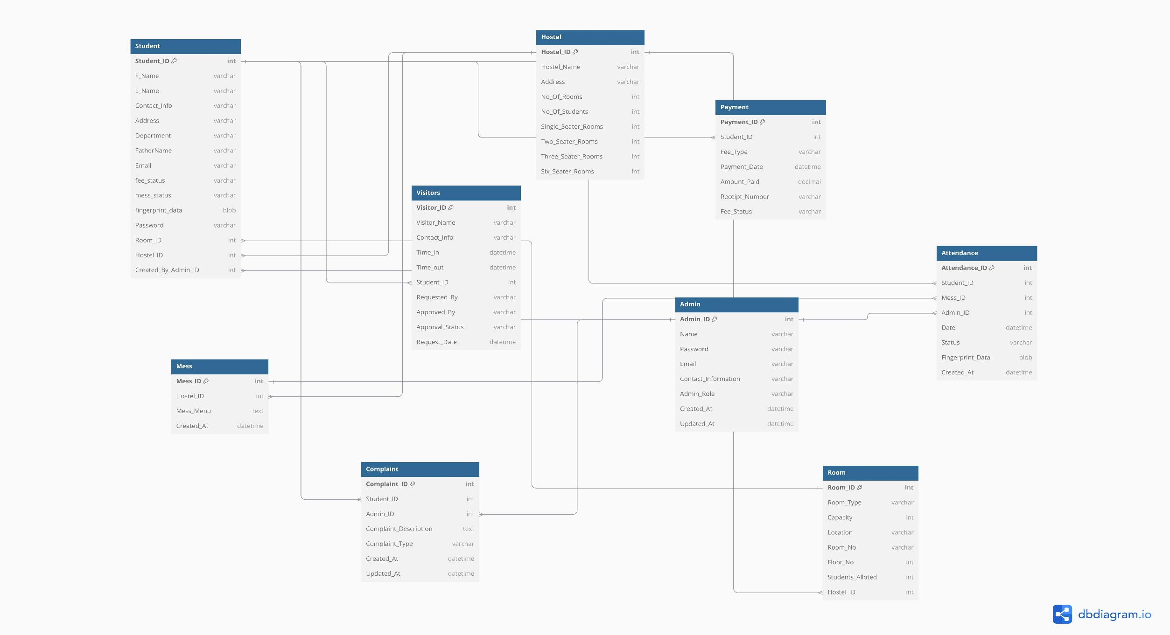
Complete ERD Diagram

Slide 30
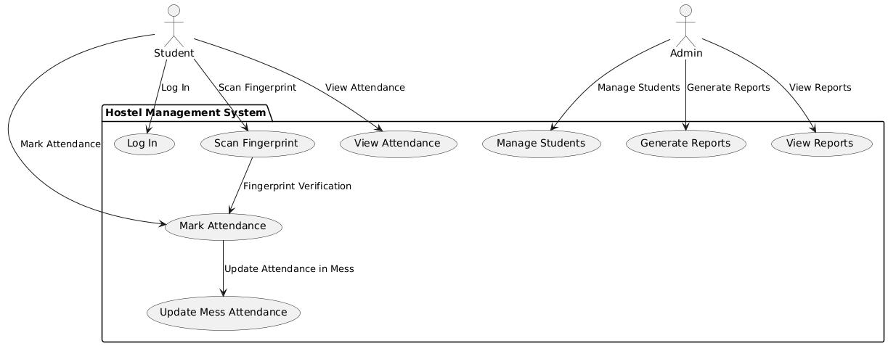

Slide 31
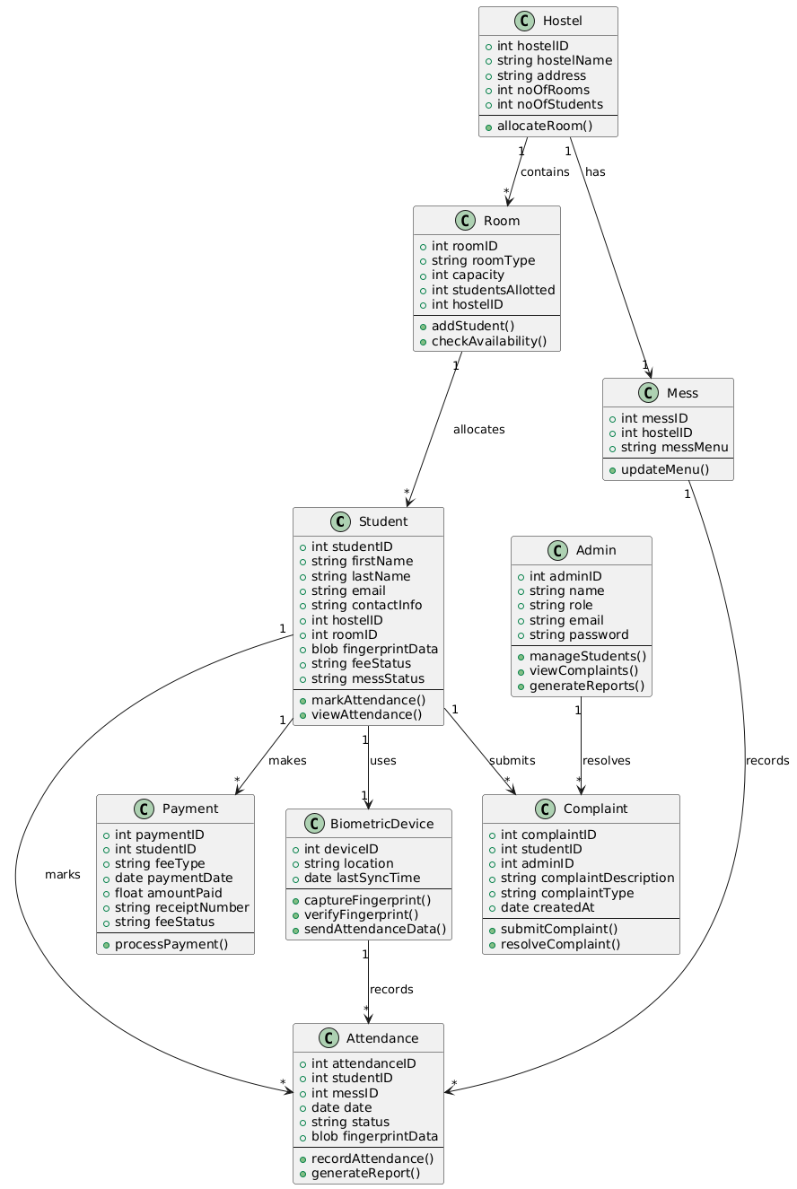
Class Diagram

Slide 32
Flow Chart:

Slide 33
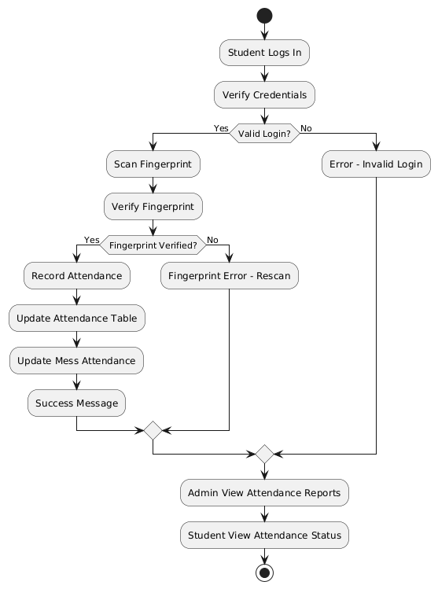

Slide 34
Sequence Diagram

Slide 35
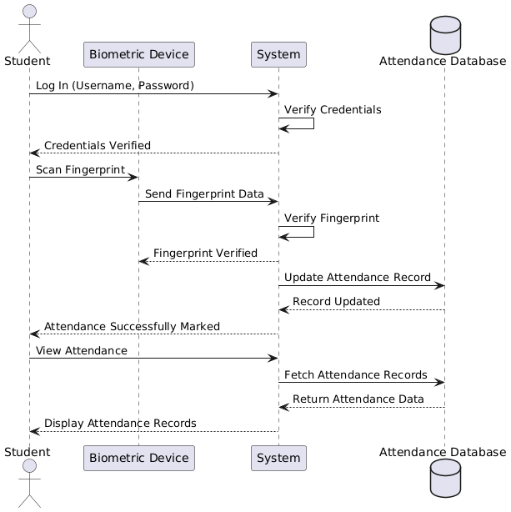

Slide 36
Use Case Diagram

Slide 38
Activity | 15 Oct - 30 Nov | 30 Dec-15 Jan | 15 Jan-20 Feb | 20 Feb-30 Mar | 1 May-15 Jun | 15 Jun-10 Jul
Requirements Gathering | √
System Design |  | √
Implementation |  | √
Implementation |  |  | √ | √
Integration and Testing |  |  |  |  | √
Documentation and Final Report |  |  |  |  |  | √

Slide 39
